Slide 1

The Master Algorithm that will rule the world?
Bill Gates recommended this book
in 2016 Code Conference
The thesis:
Processing data through a single universal learning algorithm— can get all the knowledge from the past, the present, and the future
Pedro Domingos, TMA, P. 25
Chinese Translation
1

Slide 2
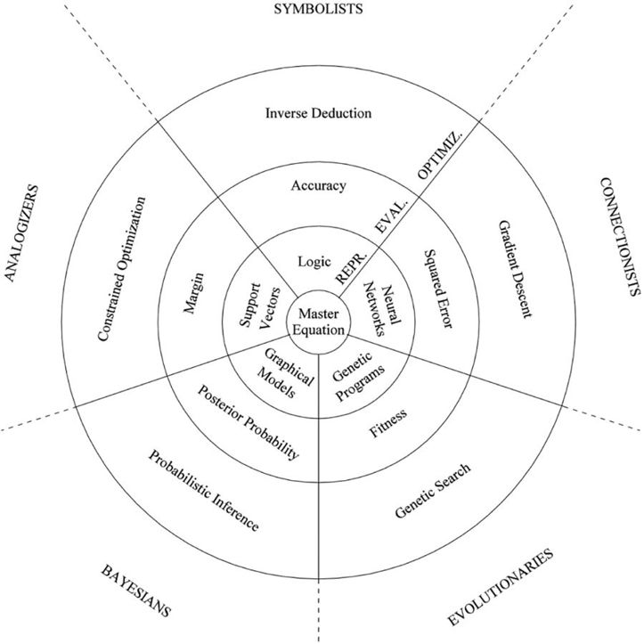
The Master Algorithm with Five Elements
Image Source: P. 240 of The Master Algorithm
2

Slide 3
The Allegory of the Master Algorithm
（寓言）
The Allegory of a Smart City made of 3 concentric circles and occupied by 5 tribes:
Practical Concerns:
Optimization (Search)
Scalability
Evaluation (Assessment and Rewrite)
Correctness
Representation (NsM)
Sound/Complete
Circles:
Optimization (Search)
Evaluation (Assessment and Rewrite)
Representation (NsM)
Master
Equation
Chinese Translation
Image Source: P. 240 of The Master Algorithm
3

Slide 4

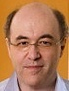
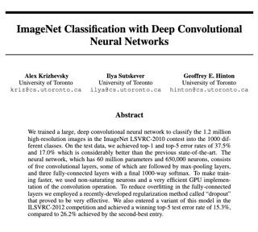
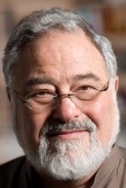





The Leaders of the Five Tribes
Image Source: P. 240 of The Master Algorithm
4

Slide 5

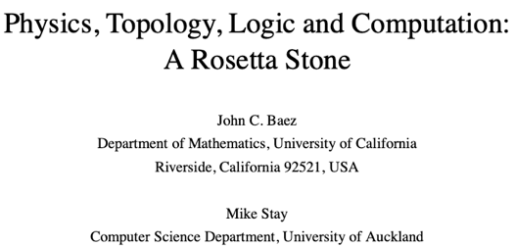
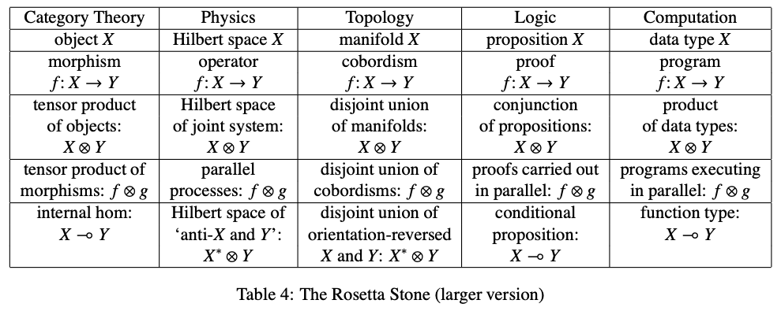
The Rosetta Stone by John Baez
Image source: wikipedia

Slide 6
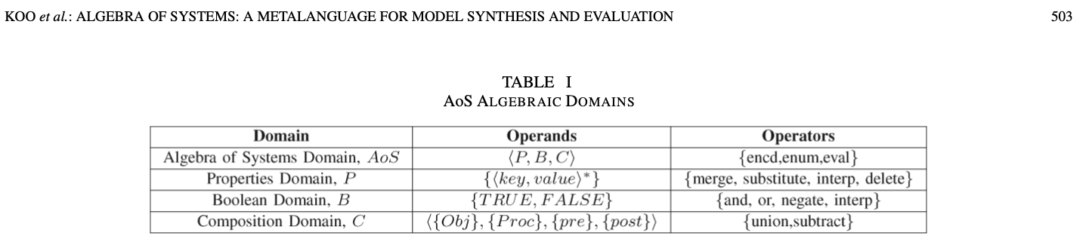
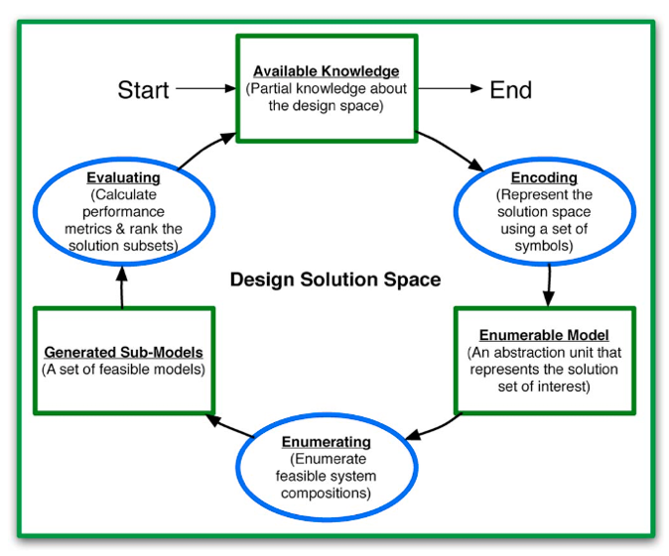
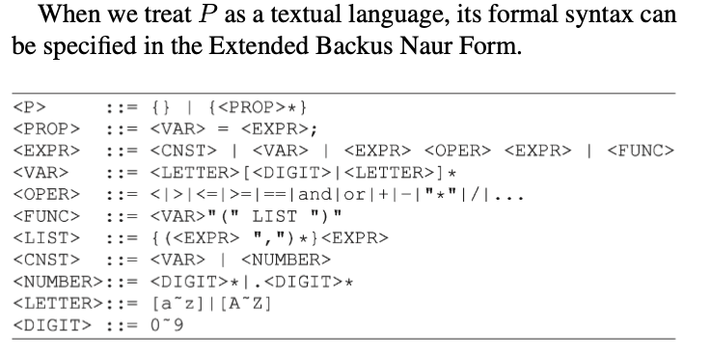
Computable Multi-level Abstractions

Slide 7
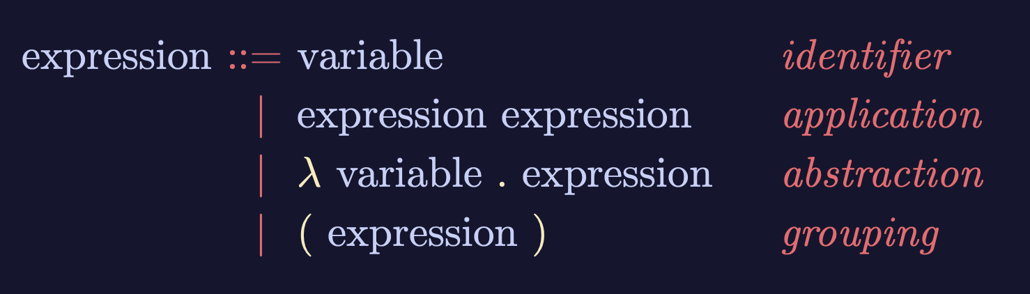


Lambda-Calculus is an Ouroboros
Variable
Expression1
Expression2
𝜆
Variable
Expression
( )
Expression
Lambda calculus as an executable rewrite process is a Lattice/Poset.
Paradigm shifting concepts
and
incommensurable terms
Normal Science
Model
Drift
Model Crisis
Model Revolution
Paradigm
Change
Learning as a vocabulary acquisition process!
Early alchemical ouroboros illustration with the words ἓν τὸ πᾶν ("The All is One") from the work of Cleopatra the Alchemist in MS Marciana gr. Z. 299. (10th Century)
Image and Text: Wikipedia
Backus-Naur Form provides a way to customize the “concrete syntax” of formal languages.

Slide 8
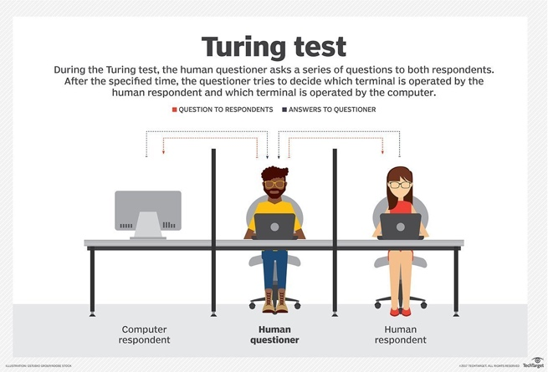


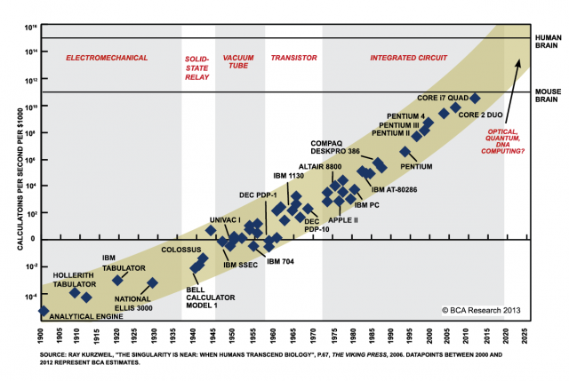
Thread 5 Intro: ICT Awareness & Competency
Ken Lazarus, Ben Koo
May 4, 2021
Moore’s Law
Notes:
https://www.aliexpress.com/item/33004770035.html

Slide 9
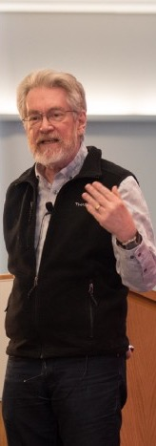

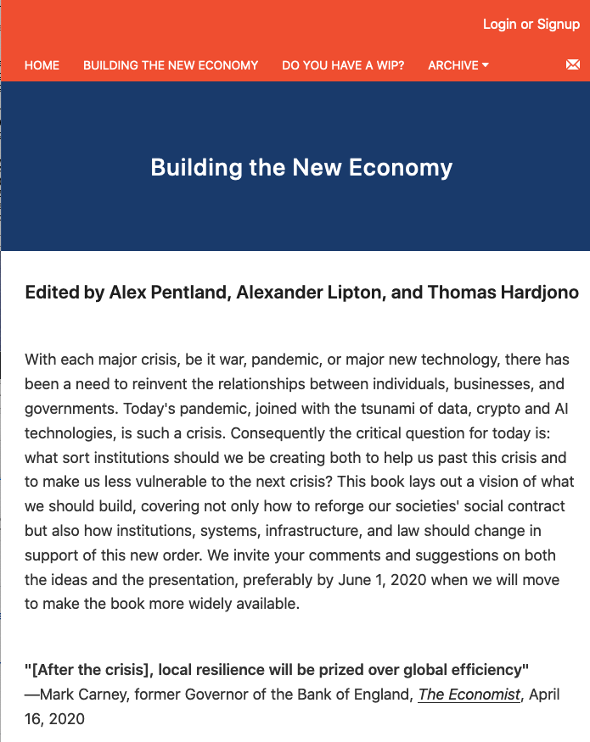
Data as the Core Asset: Code is Law

Slide 10



Types of Digital Assets
Asset Container | Operations | Tools
File(Document) | Content Editing | MediaWiki
File Directories | Changing File Structures | Git
Micro Services | Execute Programs | Docker
Configuration Data | Deployment & Maintenance | Kubernetes
Physical Environment | Physical Actions | Hackerspaces

Slide 11

The Absence of Data is a very Power Signal
Prof. Sarah Williams of MIT Urban Planning Department

Slide 12
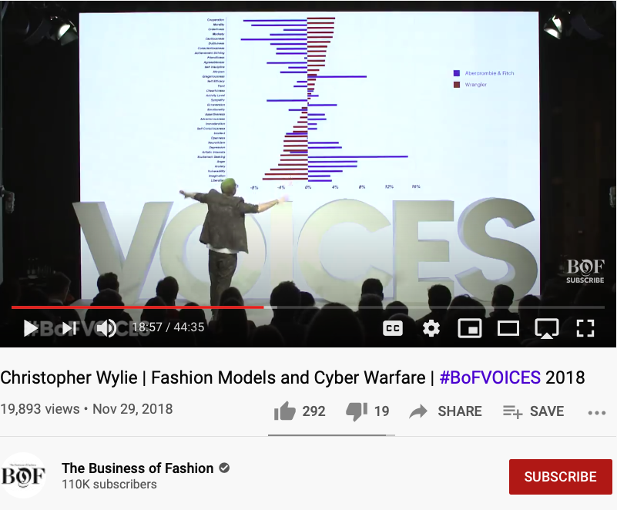
Aesthetics and Value Judgements amplified by Big Data
Huawei VP Mr. Yang Shaoqing
RICH 70 Tsinghua SEA Cloud Forum, Sep 14, 2020
H. E. Bambang Brodjonegoro,
Minister of Research & Technology, Indonesia

Slide 13
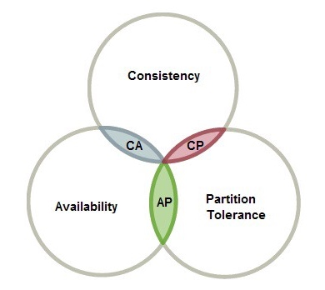
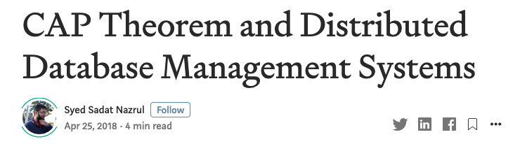
The CAP Theorem in Data Assets
RICH 70 Tsinghua SEA Cloud Forum, Sep 14, 2020
H. E. Bambang Brodjonegoro,
Minister of Research & Technology, Indonesia

Slide 14
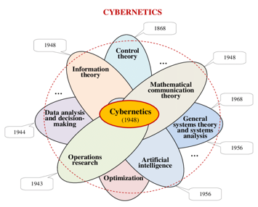
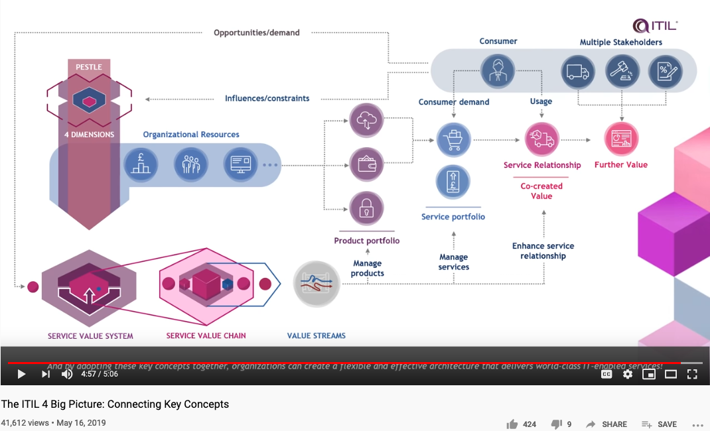
Cybernetics at a Scale of Internet Economy

Slide 15

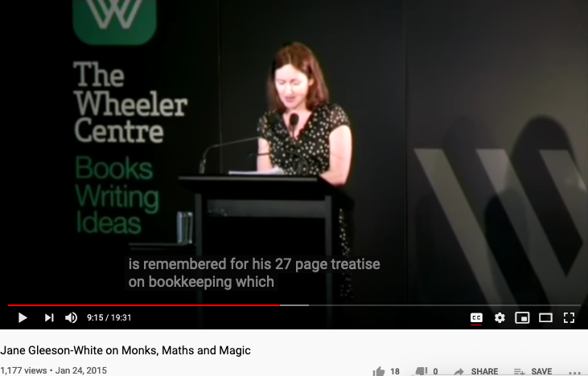
Double Entry, Monks, Maths, and Magic

Slide 16
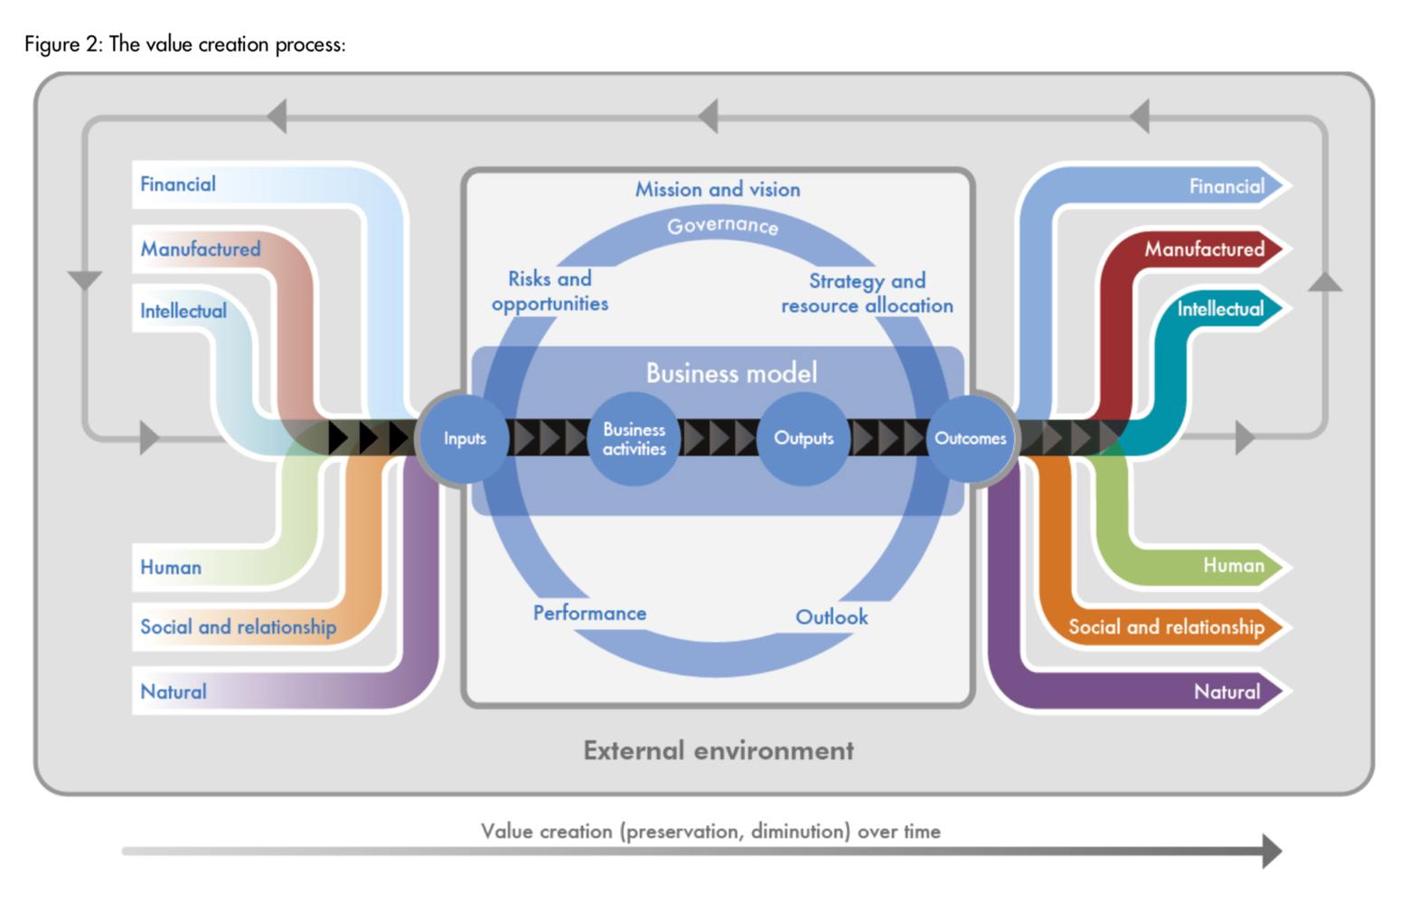

Accountants’ Value Proposition
The International
Integrated Reporting
Framework
Dec. 2013
Notes:
“historian James Aho linked double-entry bookkeeping to the ancient art of rhetoric,”
Excerpt From: Jane Gleeson-White. “Double Entry.” Apple Books.

Slide 17
The Ouroboros Structure makes Data Accountable
The International
Integrated Reporting
Framework
Dec. 2013
Notes:
“historian James Aho linked double-entry bookkeeping to the ancient art of rhetoric,”
Excerpt From: Jane Gleeson-White. “Double Entry.” Apple Books.

Slide 18
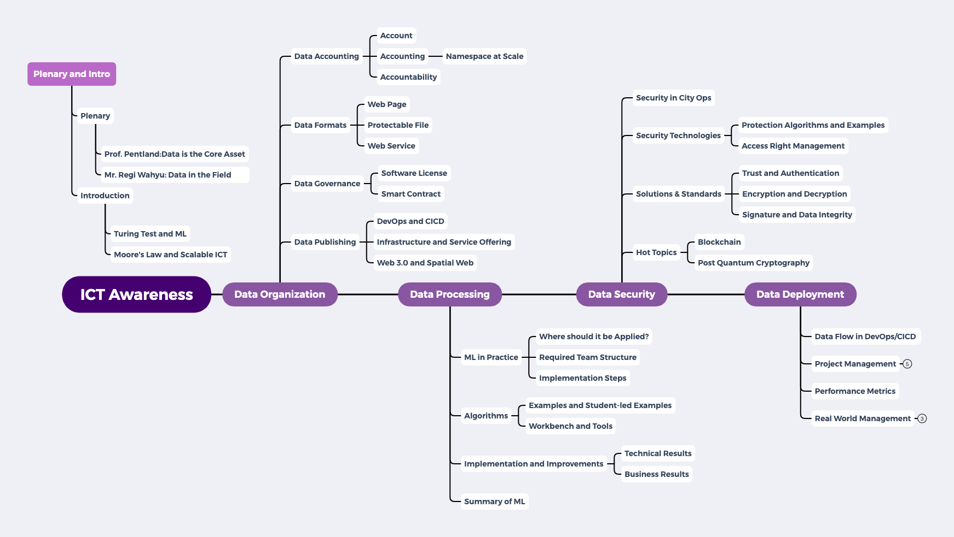
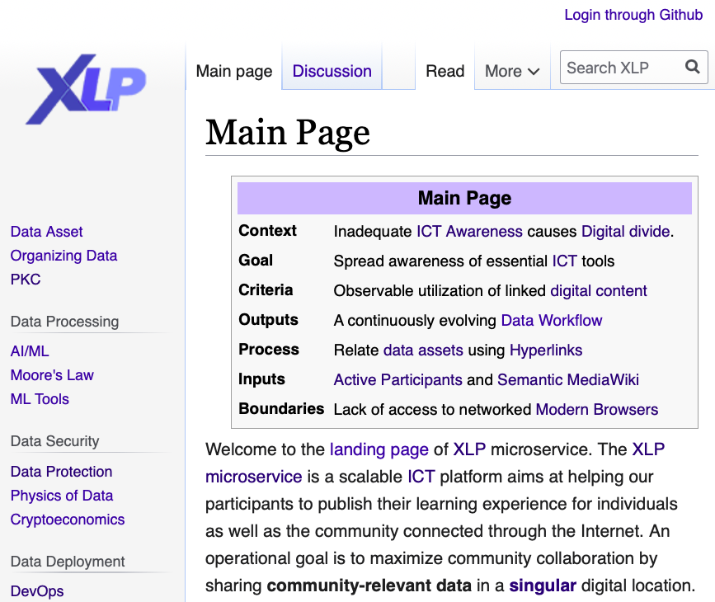
Thread 5 Content Structure

Slide 19


Abstract Specification
Logic Model
Logic Model
Concrete Implementation
Context: Inadequate ICT Awareness causes Digital divide.
Goal: Enhance awareness of essential ICT tools
Criteria:
Understand ICT terminologies
Observable utilization of Hyperlinked digital content
Output: A continuously evolving Data Workflow
Process: Relate data assets using Hyperlinks
Input:
Happy Participants
Semantic MediaWiki (PKC)
A well-defined set of Actions and iterative Branching Strategies
A Roadmap of composable activities
Sequencing and timing conditions
Explicitly state dependencies and resource requirements
Boundary Conditions: Lack of access to networked Modern Browse

Slide 20
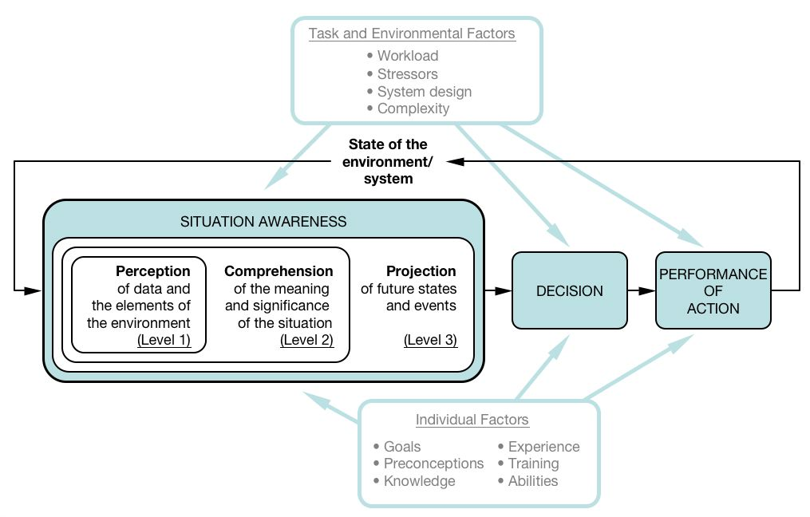
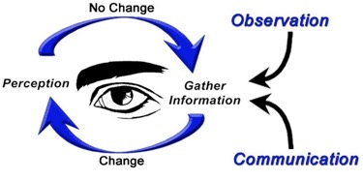
How to measure Awareness?
Endsley's model of SA. Tahis is a synthesis of versions she has given in several sources, notably Endsley (1995a) and Endsley et al (2000). Drawn by Dr. Peter Lankton, May 2007.

Slide 21
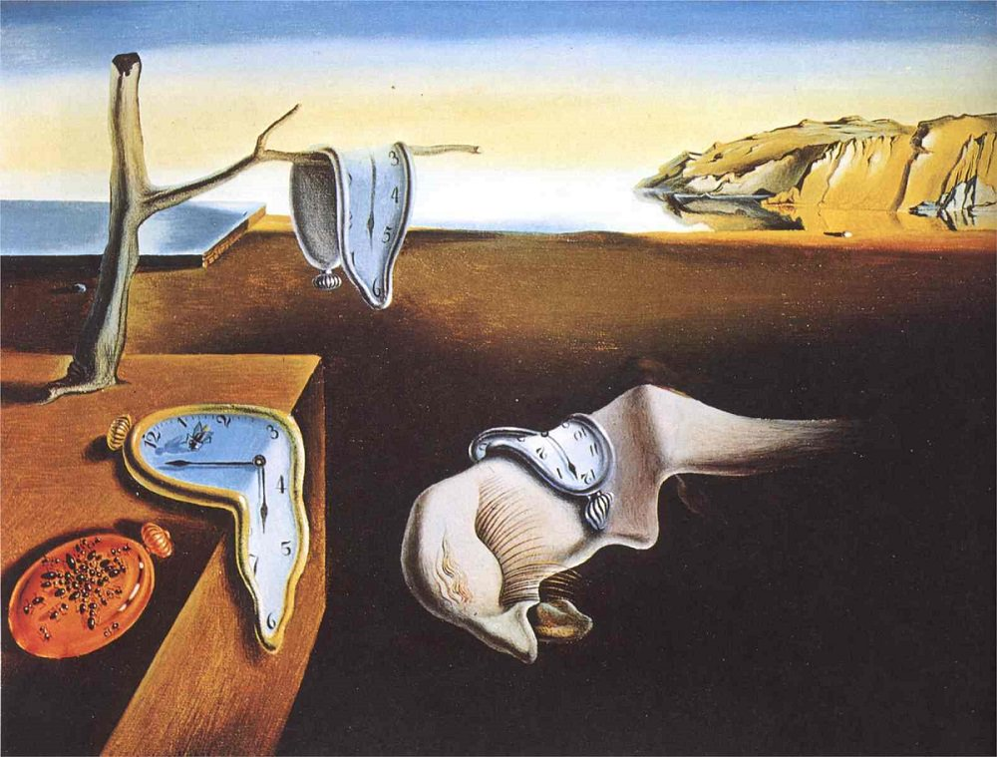
The CONTEXT of Modern ICT practices
GLOBALIZATION AND INDUSTRIALIZATION CHALLENGED THE BOUNDARY OF HUMAN COGNITIVE POWERS
THE SPEED OF CHANGES EXCEEDS MENTAL CAPACITY
Societal Implosion & Globalized Chaos
Incoherent minds and body
overwhelmed by new knowledge
lost of self-worth

Slide 22
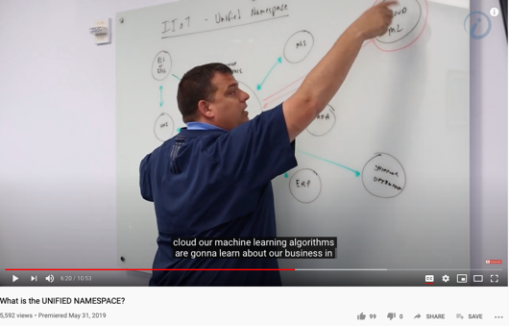
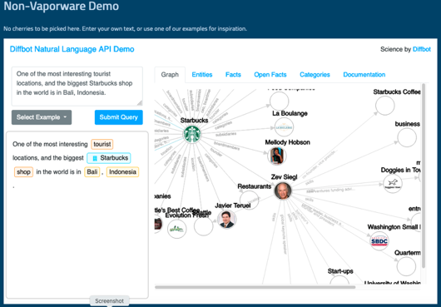
The Digital way to Govern Activities in Space-Time
Transform everything into Data
(labeling things at a Global Scale)
ICT Term:
Namespace Management
Image credits: http://verses.io

Slide 23
Learning Process as a Publishing Workflow
Traders
（students/teachers）
Miners
（Administrators/Witnesses）
Coders
(Artists/Creative People)
(Consumers/Distributors)
(Content Producers/Product Designers)
(Accountants/Lawyers)

Slide 24
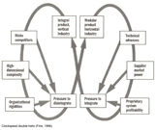
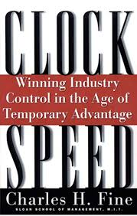


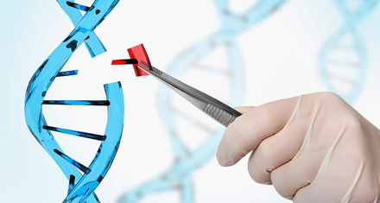
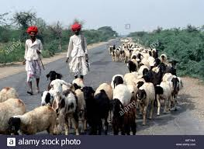
Updating Name Space to across time scales
Traders/Hunters
（students/teachers）
Miners/Herders
（Administrators/Witnesses）
Coders/DNA Editors
(Artists/Creative People)
Consumers/
Distributors
Sec
Dev
Ops
Content Producers/
Product Designers
Accountants/
Notary Service Providers

Slide 25
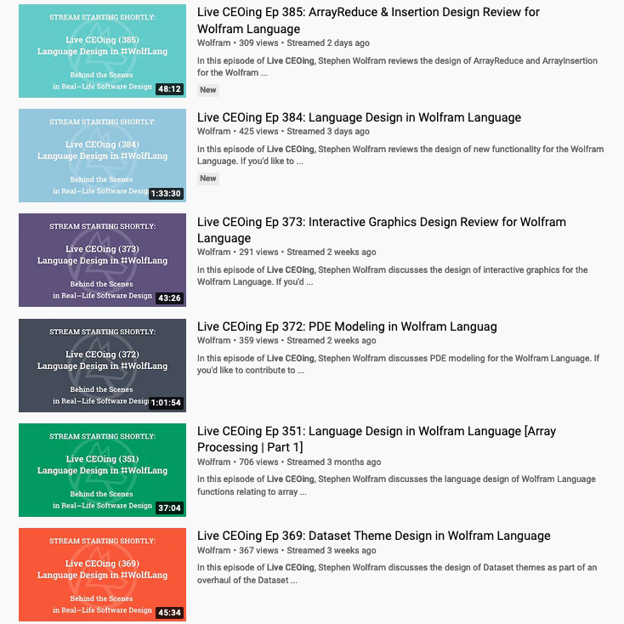
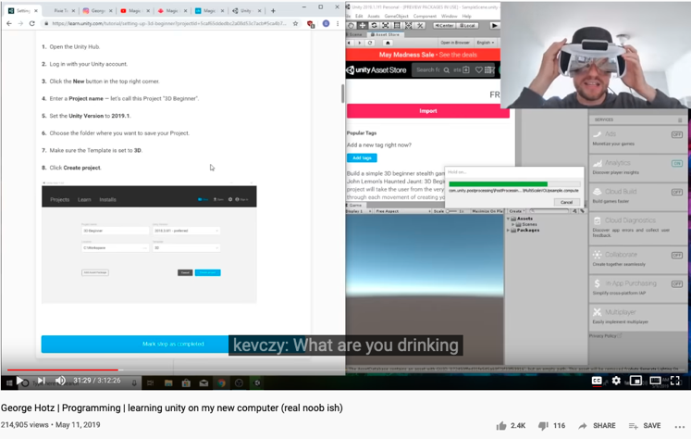
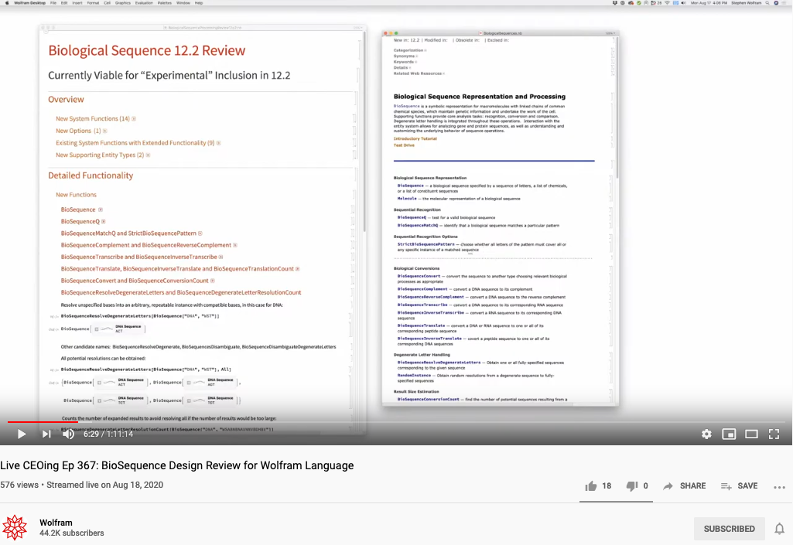
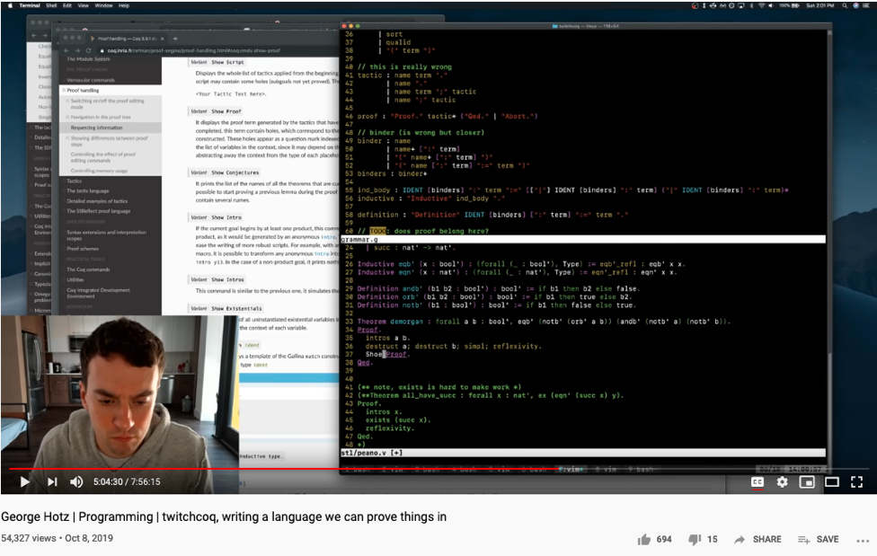
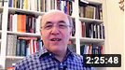
The World has changed … Ways to conduct business have changed …
https://en.wikipedia.org/wiki/George_Hotz

Slide 26
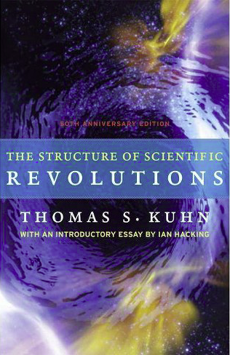
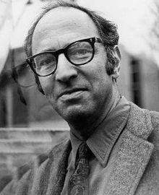
Kuhn Cycle shows innovation as “Paradigm Change”
A pardigm is a situation that cannot be represented by earlier vocabulary. Therefore, people’s “dictionary” must be
updated accordingly.
Emerging cases or
systematic attacks?
Normal Science
Model
Drift
Model Crisis
Model Revolution
Paradigm
Change
Ouroboros Snake
in five named stages
Thmoas Kuhn in 1973
Image source: wikipedia

Slide 27
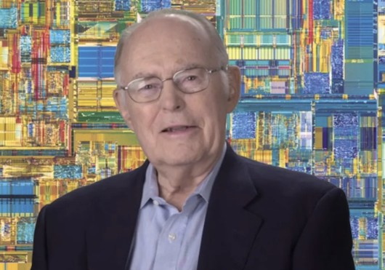
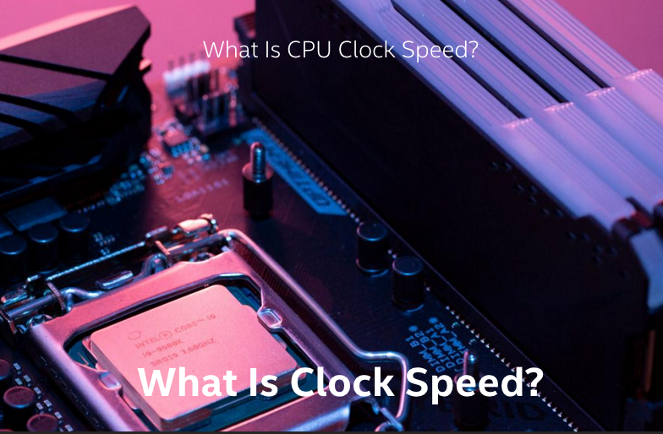

Societal Clockspeeds determine how People Think
Gordon Moore, Intel Founder
Density of transitor count doubles every 18 months…

Slide 28
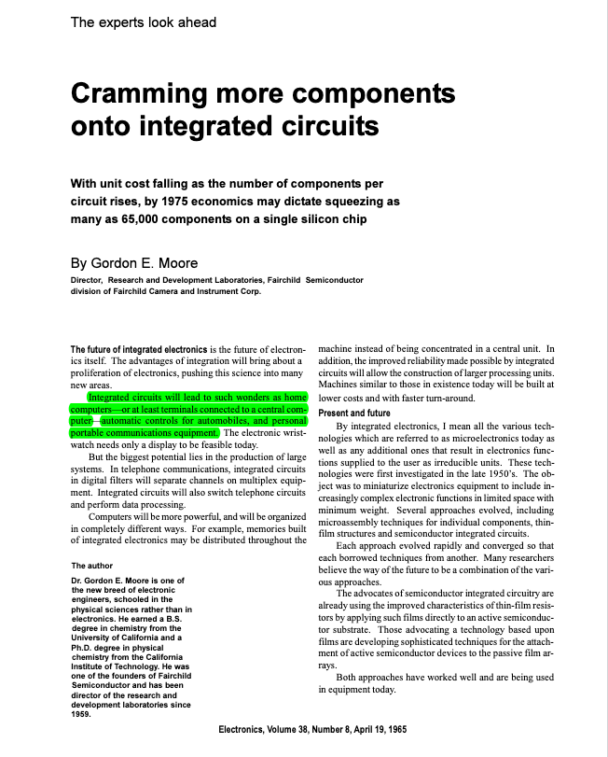
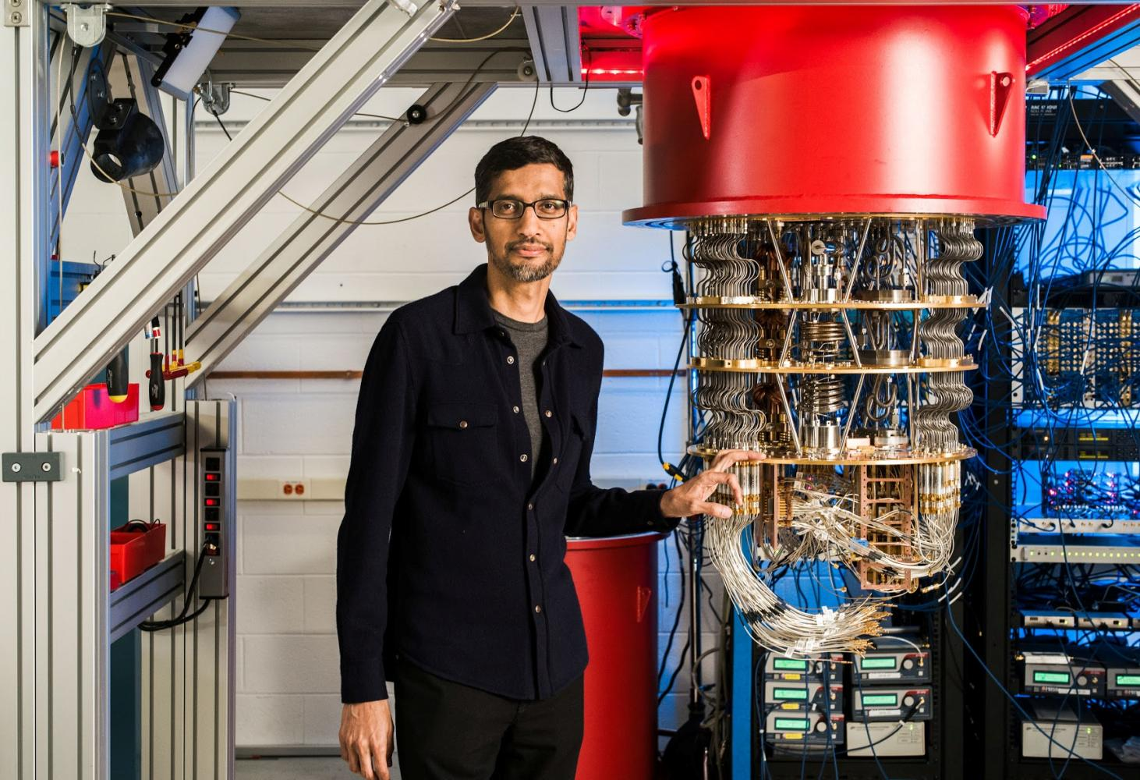
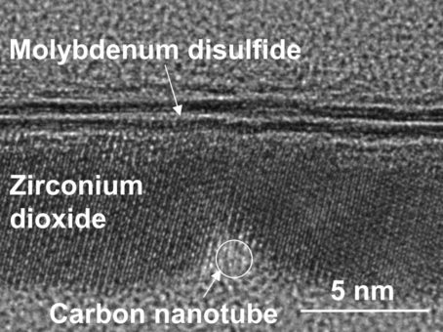
Moore’s identified a measurement to anticipate the Physical dimensions of Data
Google lays claim to 'quantum supremacy’
- Bangkok Post
The smallest Transitor, ever!
- Berkeley Lab
Notes:
https://www.etsy.com/sg-en/listing/959281905/wall-clock-salvador-dali-the-persistence?ga_order=most_relevant&ga_search_type=all&ga_view_type=gallery&ga_search_query=dali+clock&ref=sr_gallery-1-10&from_market_listing_grid_organic=1

Slide 29
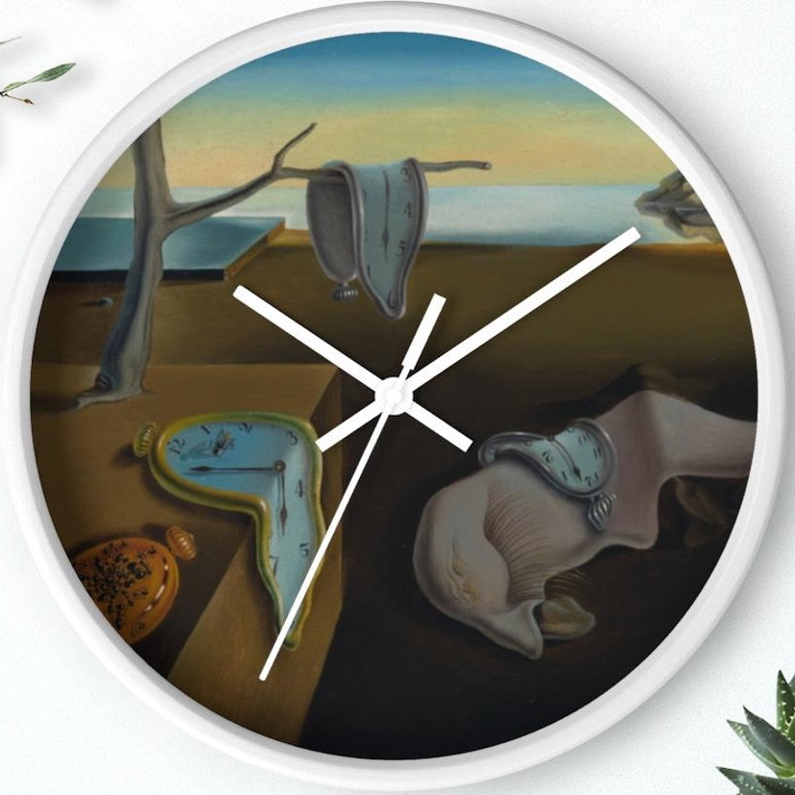
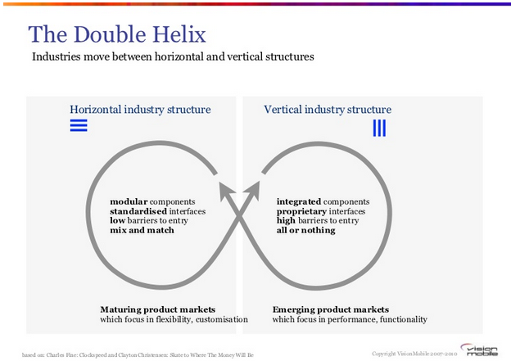
Data Awareness Learning Outcome: (Namespace Management) Managing a fast-evolving Vocabulary
Emerging cases or
systematic attacks
A world under observable acceleration in terms of Industry Clock Speed.
Normal Science
Model
Drift
Model Crisis
Model Revolution
Paradigm
Change
Moore’s Law prescribed the
anticipated clock speed
of paradigm shifts
For the last 50+ years…
See image source by clicking here
Image Source: Mobile Megatrends 2010
Notes:
https://www.etsy.com/sg-en/listing/959281905/wall-clock-salvador-dali-the-persistence?ga_order=most_relevant&ga_search_type=all&ga_view_type=gallery&ga_search_query=dali+clock&ref=sr_gallery-1-10&from_market_listing_grid_organic=1

Slide 30
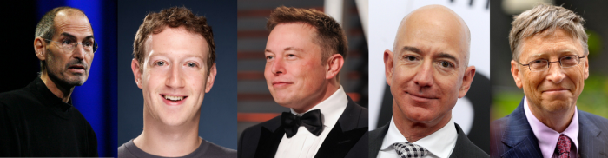
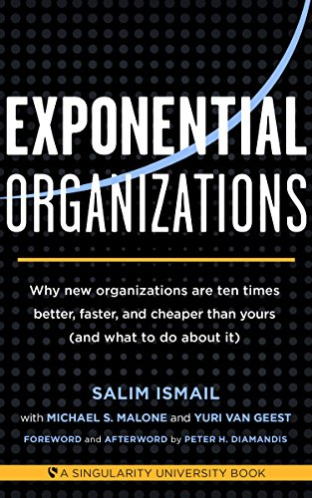
Moore’s Law is the Awareness of Exponential Opportunities
Moore’s Law equipped visionary enterpreneurs to
systematically attack traditional industries…
What Musk, Jobs , Zuckerberg, Gates , Bezos And Other Top Billionaires Have In Common That Everyone Do Not Know.
by Vivek Sakpal May 19, 2018
Normal Science
Model
Drift
Model Crisis
Model Revolution
Paradigm
Change

Slide 31
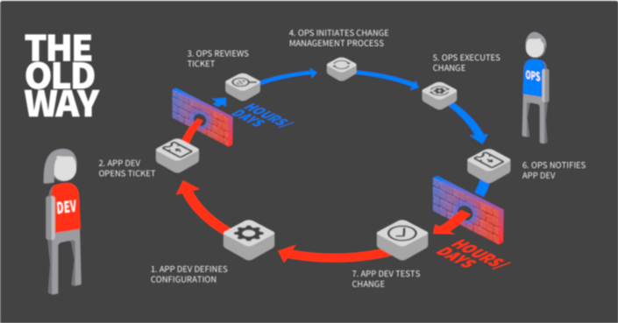

Kuhn Cycles do not have “constant” clockspeed
Normal Operations
Drifting Norms
Operational Crisis
User Revolution
Version Upgrade
?
?

Slide 32
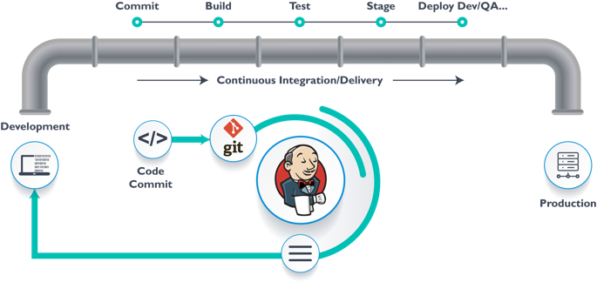
DevOps, Data Ops, AI/ML Ops, GitOps

Slide 33
One Cycle: Git as the Single Source of Truth
Normal Science
Model
Drift
Model Crisis
Model Revolution
Paradigm
Change

Slide 34

Two Cycle presents a story of DevOps
Image Source: https://devops.com/devops-ouroboros/

Slide 35


Three Cycles covers micro/meso/macro Time Scales
(students/teachers)
(Smart) Social Contract Execution
Traders
Miners
Coders
Fast Responding Web Pages
Three Asynchronous
Clocks in their respective
Communities
Micro-time Scale
(Consumers/Distributors)
Creative Content in Protectable Files
Macro-time Scale
Trust-worthy Web Services
Version Upgrade
Production Code
Function Requests
Customer Crisis
Feature Revolution
Meso-time Scale
(Artists/Creative Projects)
(Administrators/Witnesses)
Perform Checking
receive confirmation
commit transaction
(Content Producers/Product Designers)
(Accountants/Lawyers)

Slide 36


Blockchain is the “Constant” clockspeed Technology: Time (Consistency) is Money
Chained Data only becomes valuable when
they are “entangled”.
https://www.investopedia.com/terms/b/blockchain.asp

Slide 37





Enter the Age of the Web
The Semantic Web
Berners-Lee called his vision for the web “utopian.”
He wanted it to be a place where all people had access to the best information at any time.

Slide 38

Instrumentation of DevOps
Image courtesy: PETSEBAN on NearCoding

Slide 39

Digital Tools in Software Containers

Slide 40

Ricardian Contract Socially boound Digital Twin

Slide 41

Smart Contract with Observable Historical Data
ISDA: International Swaps and Derivatives Association

Slide 42

Not Information Asymmetry, but promote the Principle of Information Symmetry

Slide 43

The Mother Contract: Open and Free
Open Source
Right to use publicly available technologies and other resources in the learning process
Right to resolve conflicts in a dynamic context in digitized space
Freedom to make decisions related to one’s personal digital assets
Freedom to express one’s opinions
Free Software
Founder of Free Software Foundation, and Creator of GNU/Linux. Image credit: Wikipedia
Paraphrased from “Free Software, Free Society” by Richard Stallman

Slide 44


Three Scales of Time
Mesoscopic：
Localized Adjustments
Time Stamp
Macroscopic:
Five Stages of Evolution
Normal Science
(commit)
Model
Drift
(build)
Model Crisis
(test)
Model Revolution
(stage)
Paradigm Change
(deploy)
Microscopic：
Process Data and Summative Result
Time Stamp

Slide 45




The Notion of Universal Data Abstraction
Image source: newyorker.com
https://youtu.be/V9ohtKameio

Slide 46


Universality in Textbook

Slide 47
Universal Data Abstraction is necessary because technologies are simply not Simple Enough!

Slide 48



Jeff Bezos and his No Power Point Policy

Slide 49



Bezos’s NPPP eventually created DevOps

Slide 50

Amazon Lambda offers Function as a Service (FaaS)

Slide 51


What is the most general form of Data/Computation?
The two dashed paths shown above are homotopic relative to their endpoints. The animation represents one possible homotopy.
Image and Text Source: https://ncatlab.org/nlab/show/natural+transformation

Slide 52


ICT is the business of labeling things at scale
Henri Poincare is main figure in modern topology and physics in general.
A method that matches your application context,
without losing scope of possible alternatives.

Slide 53
Learnability of a Multi-Scale DevOps Process
Traders
（students/teachers）
Miners
（Administrators/Witnesses）
Coders
(Artists/Creative People)
Sec
(Consumers/Distributors)
Dev
Ops
(Content Producers/Product Designers)
(Accountants/Lawyers)

Slide 54




Holacracy: a mechanism for Communication and Control
Variable
Expression1
Expression2
𝜆
Variable
Expression
( )
Expression
Holacracy applied Recursively
Image Source: Holacracy: The New Management System for a Rapidly Changing World

Slide 55

Learning Resource created by leading Enterprises

Slide 56




Using AI and DevOps to create simulated Cities
(Video: https://youtu.be/hjpHsXRp790)

Slide 57


Get access to Public Data Now!
https://www.flightradar24.com/
https://www.marinetraffic.com/

Slide 58

Operationalizing the Cybernetics
How to deploy a Kubernetes Cluster from Scratch (Youtube Link)

Slide 59


Concrete Implementation ITIL: Accounting System for Safety and Liveness
RICH 70 Tsinghua SEA Cloud Forum, Sep 14, 2020
H. E. Bambang Brodjonegoro,
Minister of Research & Technology, Indonesia
p.33 of ITIL for Dummies
By Peter Fareden
p.97 of Effective IT Service Management to ITIL and Beyond
By Rob Addy

Slide 60

Early design document of Personal Knowledge Container

Slide 61

Representing Collective Consciousness Principe of Information Symmetry
Public Domain Data
Contractual Data
Private
Data
Sec
Dev
Ops
Spiritual
Ecological
People
“Language is an organ of perception, not simply a means of communication”
― Julian Jaynes

Slide 62
Abstraction
Concretization
Serve as the Control Plane
Define Policies according to high level objectives
Security roles protected by tech not by political influence only
Law enforcement by controlling targeted resources in the Data Plane
Serve as the Data Plane
Resources governed by Configurable Policies
Security-sensitive infrastructure that assigns traceable responsibilities to persons
Provide feedback from real worlds to reflect on the efficacies of laws
A well-defined set of Actions and iterative Branching Strategies
A Roadmap of composable activities
Sequencing and timing conditions
Explicitly state dependencies and resource requirements
Namespace (Data Asset) Management

Slide 63
Abstraction
Concretization
Safety
Nothing
bad happens
Liveness
Some
Good Things
Must Happen
A well-defined set of Actions and iterative Branching Strategies
A Roadmap of composable activities
Sequencing and timing conditions
Explicitly state dependencies and resource requirements
Correctness

Slide 64

Abstraction
Separate Specification from Abstraction
Concretization
Why is abstraction useful?
Allow reuse through universal properties
Avoid resource conflicts
Scale free and domain neutral
Generalizing concrete experience?
Make analogies in localized contexts
Engage sensible metaphors
Define terms and boundaries
A well-defined set of Actions and iterative Branching Strategies
A Roadmap of composable activities
Sequencing and timing conditions
Explicitly state dependencies and resource requirements

Slide 65

Ben Koo
Coordinator for Thread 5: ICT Awareness and Competency
Instructor for Module 5A: Data Organization
benkoo@tsinghua.edu.cn

